Slide 1
PEP Grade 4A · Unit 1
Helping at home
Lesson 1 Asking about family jobs
Today: ask, answer, and talk about jobs.
Notes:
[Sources] Textbook Unit 1 title and Part A scope from user supplied PEP Grade 4A textbook PDF pages 7-10. Visual style references from user supplied worksheet screenshots.

Slide 2
LESSON 1
What will students learn?
1
Words
farmer · nurse · doctor · office worker · factory worker
2
Sentence
What's your mother's job? She's a doctor.
3
Practice
Ask and answer with partner cards.
Quick output standard
Notes:
[Sources] Learning objectives inferred from Unit 1 Part A Let's talk and Let's learn textbook pages 9-10.

Slide 3
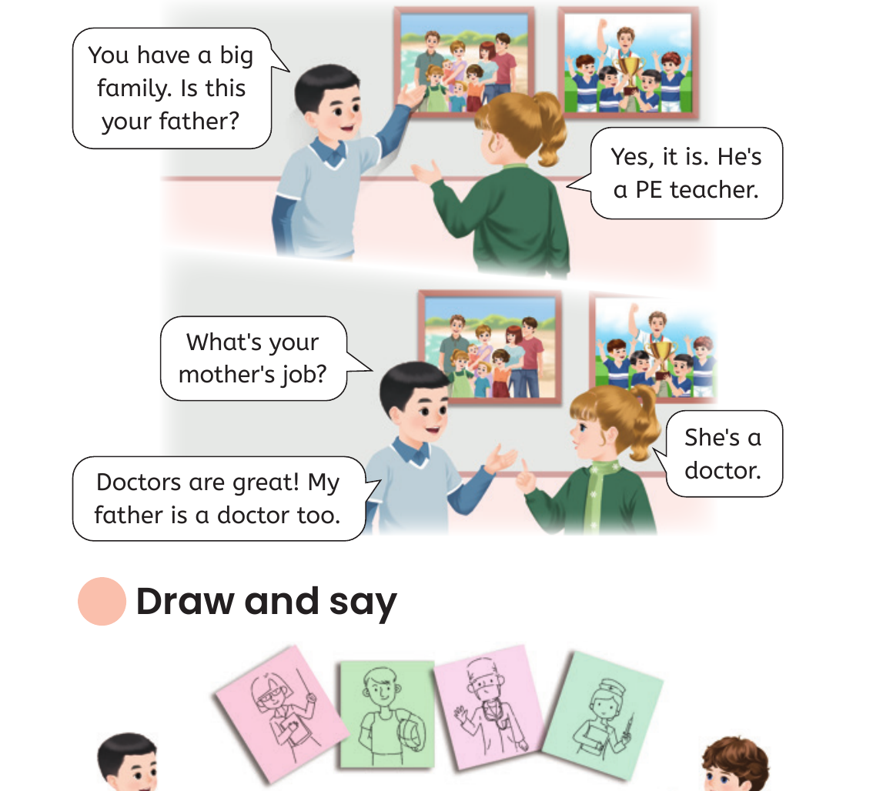
WARM UP
Look at the family picture
Ask first
Who can you see?
Is this his father?
What's his mother's job?
Teacher cue: point, pause, let students answer with one word first.
Notes:
[Sources] Textbook Let's talk visual and questions from user supplied PEP Grade 4A textbook PDF page 9.

Slide 4
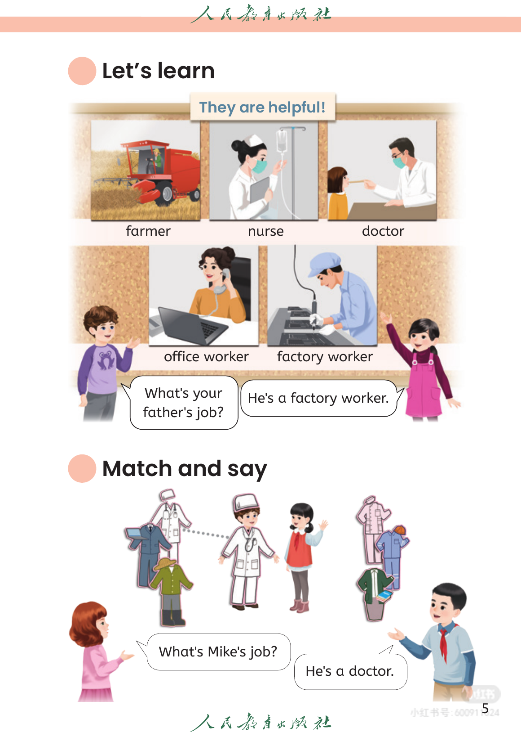
WORDS
They are helpful!
farmer
nurse
doctor
office worker
factory worker
Read three times: word → picture → sentence.
Notes:
[Sources] Vocabulary list from textbook Unit 1 Part A Let's learn page 10.

Slide 5
SENTENCE
Ask and answer about jobs
What's your mother's job?
She's a doctor.
你的妈妈是做什么工作的？
回答女生/女性：She's ...
What's your father's job?
He's a factory worker.
你的爸爸是做什么工作的？
回答男生/男性：He's ...
Grammar note: use a/an before one job.
Notes:
[Sources] Sentence patterns from textbook Unit 1 Part A Let's talk and Let's learn pages 9-10. Grammar note is a teaching inference based on the textbook example sentences.

Slide 6
LET'S TALK
Read, role-play, then change
Step 1
Listen and point
Step 2
Read after teacher
Step 3
Boys ask, girls answer
Step 4
Change father / mother / job
Notes:
[Sources] Dialogue practice based on textbook Unit 1 Part A Let's talk page 9. Classroom sequence follows teacher workflow: PPT for vocabulary and grammar, then oral practice.

Slide 7
PAIR WORK
Ask your partner
doctor
farmer
nurse
office worker
factory worker
teacher
A: What's your mother's job?
Change: mother → father, she → he
B: She's a/an ________.
Notes:
[Sources] Job words and sentence patterns from textbook Unit 1 Part A pages 9-10.

Slide 8
QUICK CHECK
Can you say it?
1. What's your mother's job?
2. He's a farmer. Is it father or mother?
3. Make one sentence with office worker.
Homework: ask one family member's job and write 2 sentences.
Notes:
[Sources] Quick check and homework are generated from the textbook vocabulary and grammar goals for Unit 1 Lesson 1.

